Slide 1
Capstone university analysis Project
Gayatri Nandeshwar

Slide 2
Project Overview
The objective of this project is to develop a comprehensive Power BI dashboard utilizing data from various university ranking systems, offering valuable insights into the global higher education landscape. The dashboard will offer actionable recommendations for universities to improve their rankings, attract international students, and optimize resources.
In addition to the Power BI dashboard, the project includes Exploratory Data Analysis (EDA) using SQL queries. These queries are employed to extract and analyse the dataset, uncovering factors influencing university rankings, changes over time, and correlations between different variables. To effectively present the results of EDA, visualizations are prepared and organized in an Excel file. These visualizations, including charts, graphs, and tables, highlight key findings and patterns.

Slide 3
The Processes:
1) Data Acquisition from GitHub:
This step involves gathering data for university success analysis from a designated university repository (GitHub). It encompasses collecting data related to university rankings from various ranking systems, along with demographic information and performance metrics.
2) Data Transformation:
Data transformation is a critical step in project that involves to check whether the data has meaningful analysis. The techniques include data filtering, where have to select relevant rows and columns, and data aggregation, which allows us to group and summarize information. Also need to perform data joining to combine multiple datasets using common keys.

Slide 4
The Processes:
3) Data Cleaning:
Data cleaning is a step which is used to remove the unwanted data from the dataset to improve data quality and accuracy. In this Step, Managing null and zero values, resolving inconsistent data, and rounding numerical data are vital tasks in data cleaning. Redundant or removed irrelevant data, and code mapping assigns meaningful labels to codes.
4) MECE Breakdown:
A MECE (Mutually Exclusive, Collectively Exhaustive) strategy, the university success analysis project is structured into four distinct phases, aligning with specific aspects of the data obtained from the university repository. These phases include University graphics & Distribution, University Ranking System Analysis, University Metrics and Performance, and Trends and Patterns.

Slide 5
The Processes:
5) Connecting with Tools:
SQL scripts play a crucial role in project, enabling us to extract and manipulate data directly from a relational database. It supplies connectivity to SQL databases, allowing us to input SQL scripts and query data. Through power bi, data can be easily manipulate, transform, and visualize directly, thus simplifying the data preparation.
6) Exploratory Data Analysis:
Exploratory Data Analysis (EDA) is a first step in the university success analysis project. Beginning with the EDA process, SQL queries are employed to address specific problem statements using data from the university repository. The combination of SQL for data analysis and Excel for visualization results in a dynamic and interactive approach to EDA.

Slide 6
The Processes:
7) Power-Bi Analysis:
In the university success analysis project, Power BI serves as a crucial platform for creating interactive and insightful visualizations that translate raw data into meaningful representations. This step involves various visualization techniques such as Bar/Column charts, Pie charts, Area charts, Line charts, and matrix charts to present key factors from the EDA phase.
8) Documentation:
Documentation is a cornerstone of project, ensuring that organized work, accessible, and comprehensible to all stakeholders. I have created a comprehensive documentation strategy that includes diverse types of files to capture the various aspects of the project.

Slide 7
Table Explanations
Country Table: A catalogue of countries included in the dataset, providing a fundamental geographic context.
Table contains
ID: - A unique identifier assigned to each country.
Country name: - Name of each Country
University Table: This table include universities featured in the ranking systems, with each institution linked to a specific country.
Table contains
ID: - Unique identifier for each university.
country ID: - Identifier of the country to which the university belongs.
University name: - Name of the University

Slide 8
Table Explanations
Ranking System Table: Contains details about the three distinct ranking.
Table Contains
ID: - Unique identifier for each ranking system.
System Name: - Name Of Each Ranking System
Ranking Criteria Table: This table delineates the various criteria utilized in each ranking system, encompassing aspects such as citations and quality of education. Table Contains
ID: - Unique identifier for each ranking criterion.
Ranking system id: - ID of Ranking System.
Criteria name: - Name of each criterion.

Slide 9
Table Explanations
University Year Table: Provides data on university-specific metrics across multiple years,
Table Contains
University id: - ID Of the University
Year: - Year of observation.
Num students: - Total number of students In the University
Student staff ratio: - student to staff ratio Of Each University.
Pct international students: - Total Percentage of International Students in Each Country.
Pct female students: - Total Percentage of Female Students in Each Country

Slide 10
Table Explanations
University Ranking Table: This extensive table furnishes scores for each university across various years and ranking criteria, serving as the primary repository of ranking data.
Table contains
University id: - Id of University
Ranking criteria id: -ID Of Ranking Criteria.
year: -Year of assessment.
score: - Score of each University

Slide 11
Power bi query solving

Slide 12
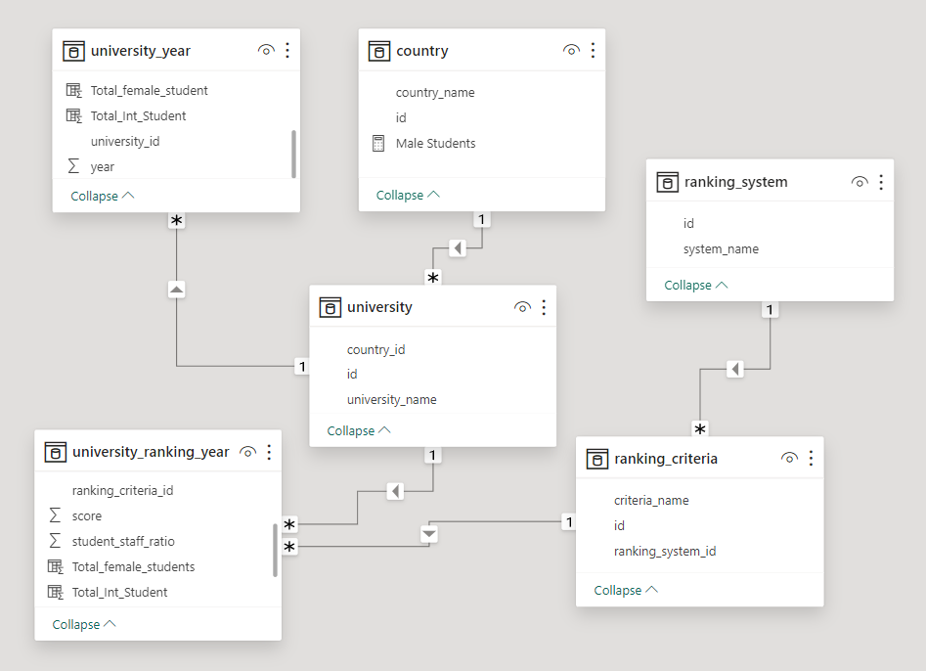
Entity Relationship (ER) Diagram

Slide 13
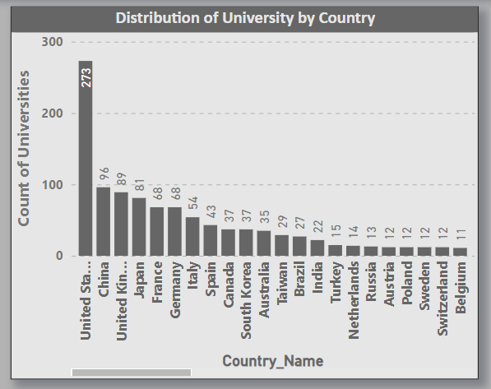
Q1) How many universities are there in each country?
As per the analysis the country with highest university is United State of America, then on 2nd place is China followed by united kingdom and others

Slide 14
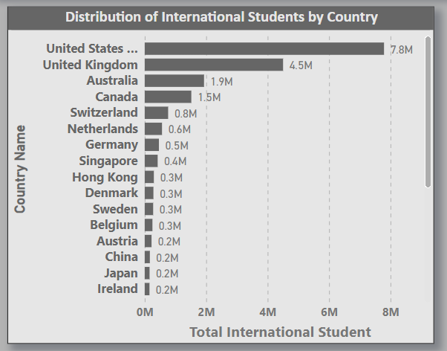
Q2) What is distribution of International Students across different country?
As per analysis the chart show the count of international students across various country. Highest is the United state of America followed by united kingdom and Australia.

Slide 15
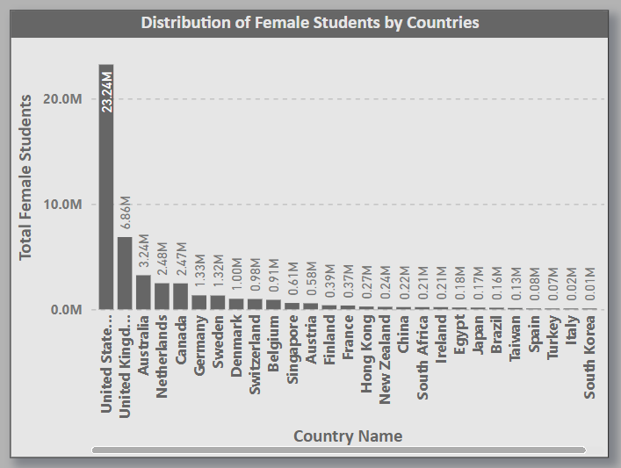
Q3) Which Country has the highest number of female students enrolled in universities?
As per analysis the chart show the count of female students in different university. Highest is the United state of America followed by united kingdom and Australia.

Slide 16
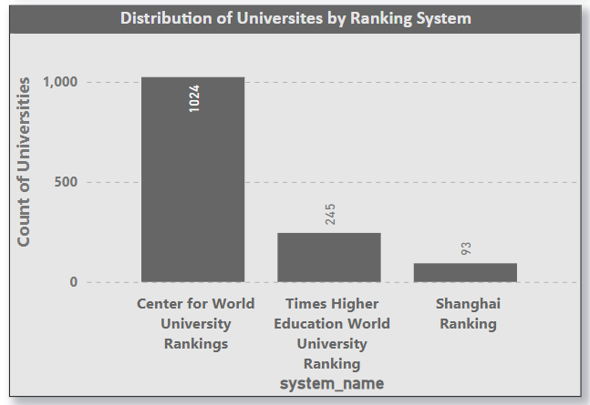
Q4) How many universities are ranked by ranking system?
There are 3 main ranking system and as per the analysis the chart shows the university rank as per ranking system. The highest ranking system is Center for world university.

Slide 17
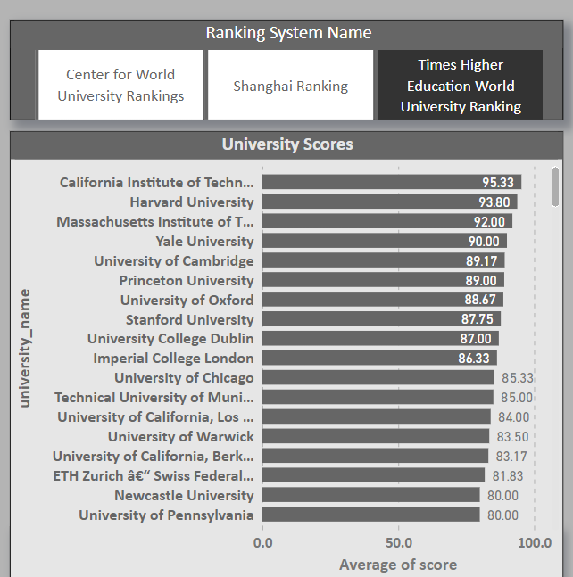
Q5) What is the average score for university according to each ranking system
As per the chart we can analysis the average score of the university according to ranking system.

Slide 18
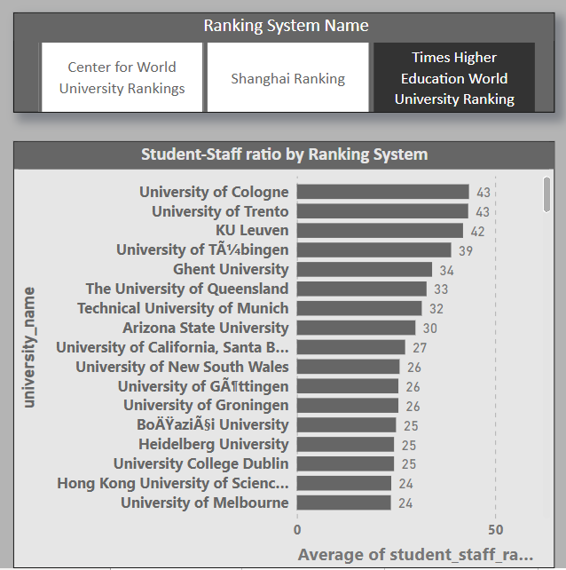
Q6) How does the ranking system affect a university student-staff ratio?
As per analysis the chart shows the average of student_staff ratio as per university and ranking system.

Slide 19
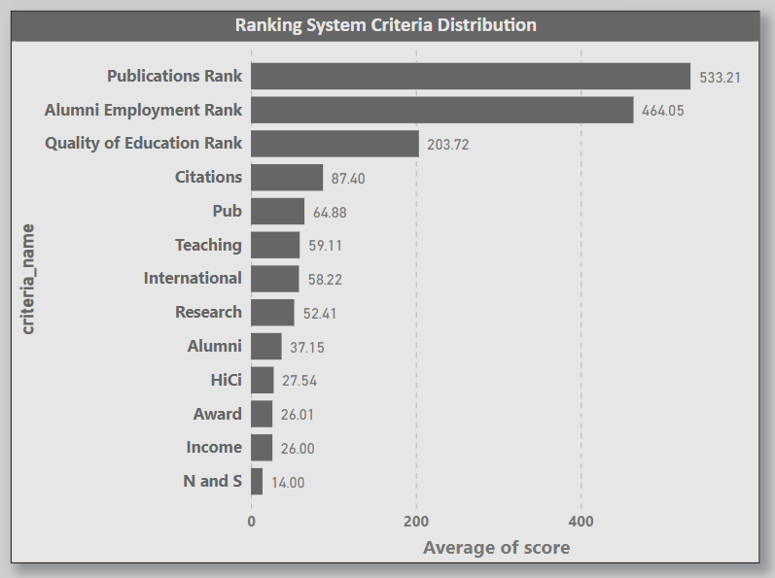
Q7) What are the most important criteria considered by ranking systems?
Here in the chart we can analysis the average score of different criteria considered by ranking system.

Slide 20
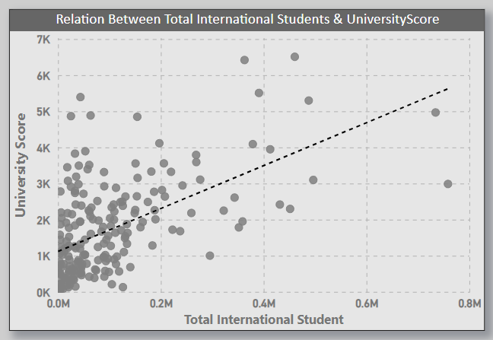
Q8) Is there a correlation between a university's score and the number of international students?
The scatter chart represents the relation between the university’s score and international students.

Slide 21
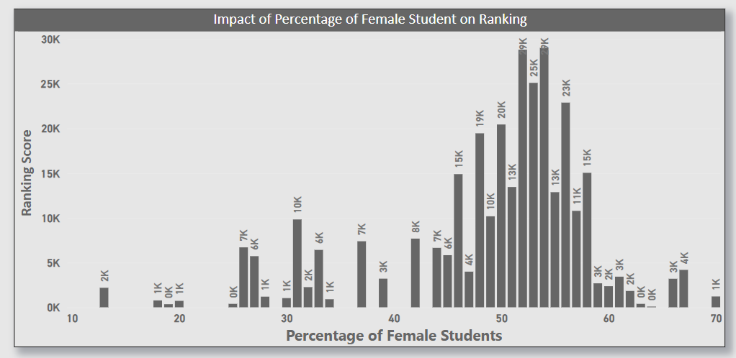
Q9) How does percentage of female student’s impact University’s ranking?
The chart shows who the percentage of female students impact the university ranking.

Slide 22
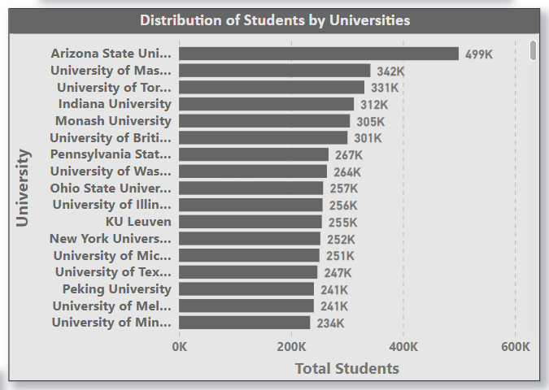
Q10) Which university has the highest number of students?
The chart analysis shows the total number of students in each university. As per the chart the highest university is Arizona State university followed by others

Slide 23
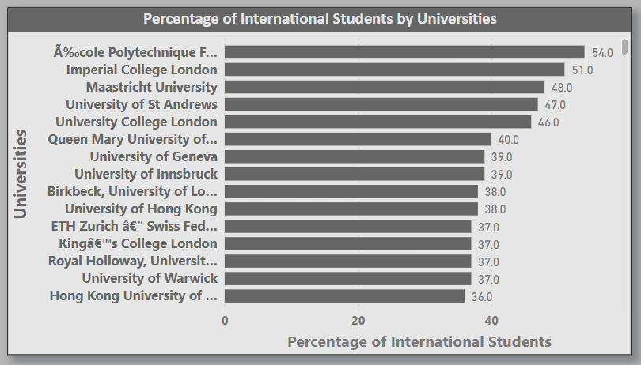
Q11) How does the percentage of international students vary across different universities?
The analysis shows the percentage of the international students across different university.

Slide 24
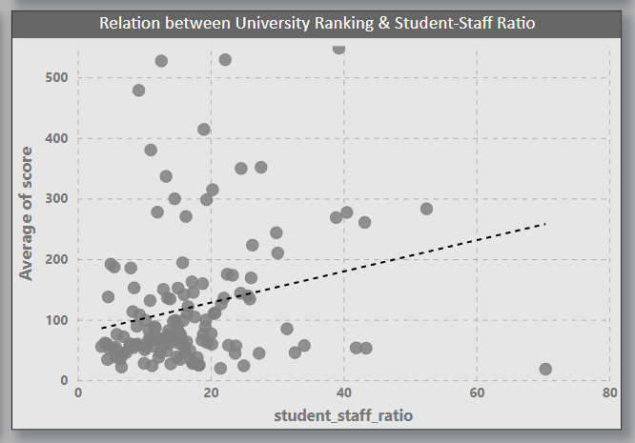
Q12) Is there a correlation between a university's ranking and its student-staff ratio?
The scatter plot shows the Average score of university and student_staff ratio

Slide 25
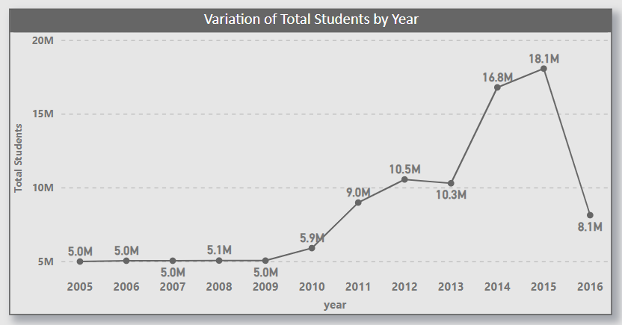
Q13) How does the number of students in universities change over time?
The line chart shows the analysis of change in number of students in university as per years. Highest number of students is in 2015 and lowest is in 2005 & 2006

Slide 26
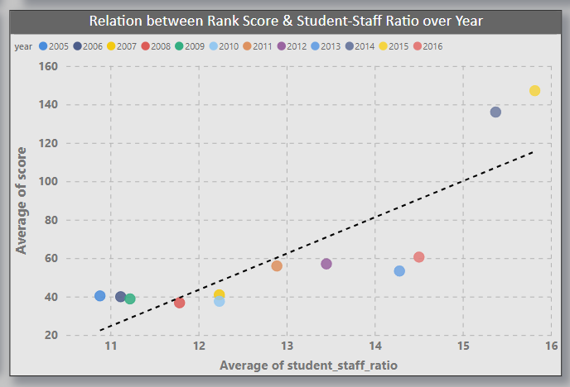
Q14) Is there a correlation between a university's ranking score and the student-staff ratio over the years?
The scatter line chart show the relation between a university ranking score and the student_staff ratio as per the years.

Slide 27
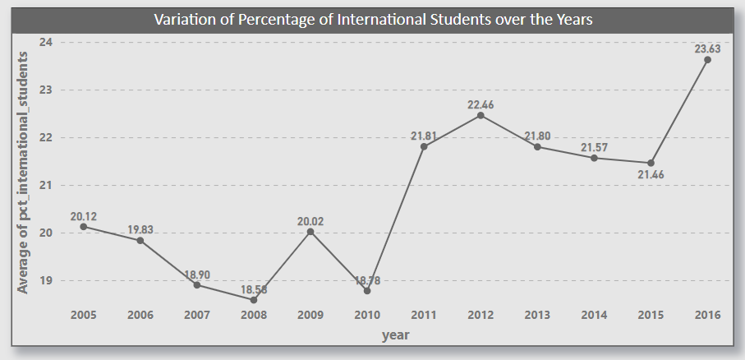
Q15) How does the percentage of international students vary across different years?
The line chart shows the analysis of changes in percentage of internation students according to various years

Slide 28
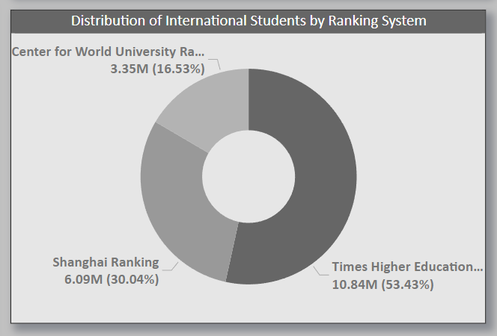
Q16) What is the impact of a university's ranking on the number of international students it attracts?
The donut chart shows the percentage of impact of university ranking over the number of international students

Slide 29
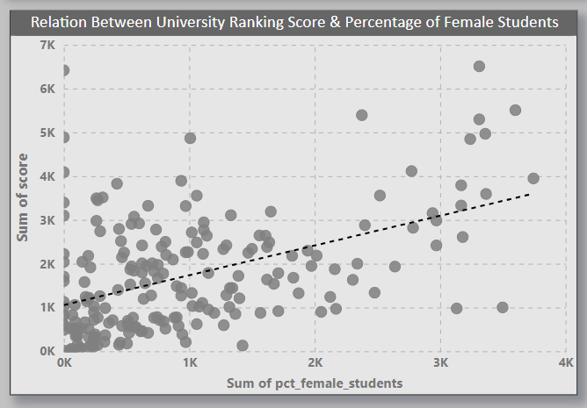
Q17) Is there a relationship between a university ranking score &the percentage of female students enrolled?
The scatter plot show the relation between university ranking score and percentage of female students in the university

Slide 30
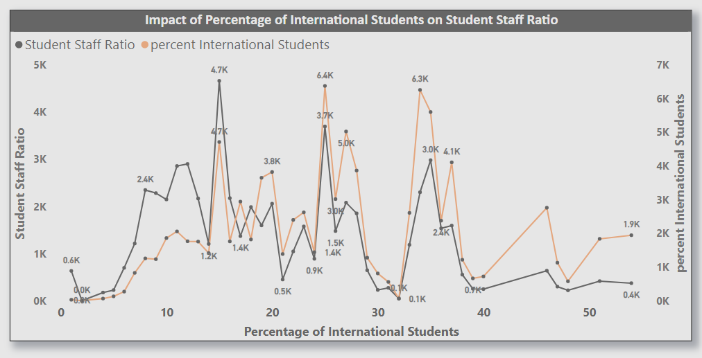
Q18) How does the percentage of international students affect a university's student-staff ratio?
The line chart shows the analysis of how a international students percentage affect the student_staff ratio

Slide 31
EDA Question solving

Slide 32
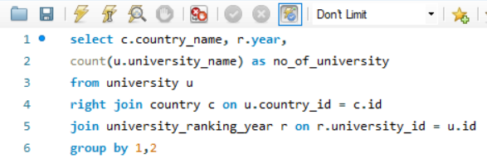
Q2. How number of universities changed over the years in each country?
Query solved using SQL
Output of query

Slide 33
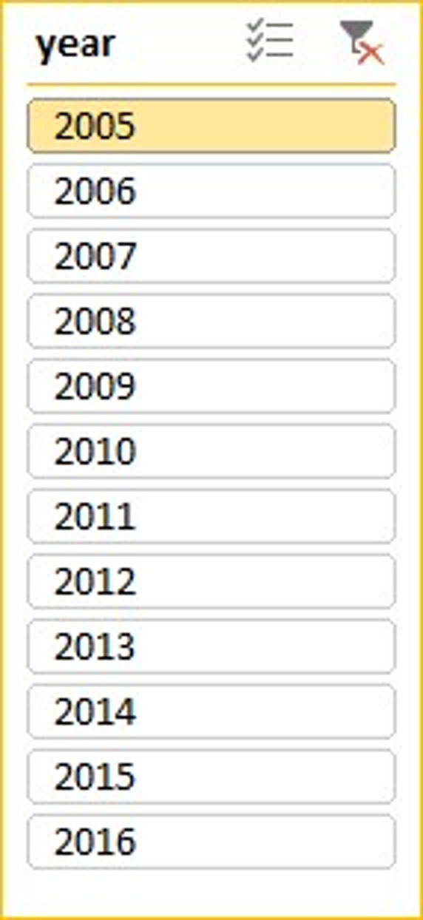
Q2. How number of universities changed over the years in each country?
Graphic presentation

Slide 34
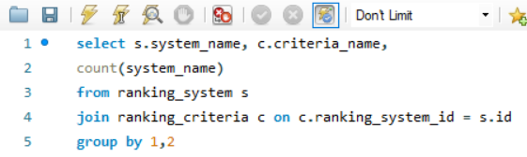
Q4.Are there any common criteria used by different ranking systems.
Query solved using SQL
Output of query

Slide 35
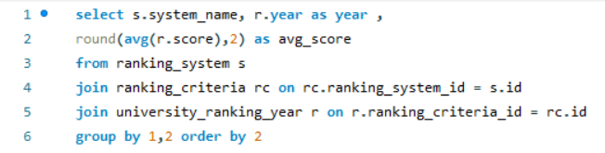
Q5. What is the trend in university rankings over the years according to each system?
Query solved using SQL
Output of query

Slide 36
Q5. What is the trend in university rankings over the years according to each system?
Graphic presentation

Slide 37
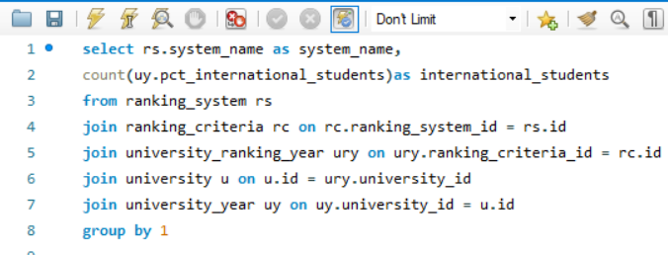
Q6. How does the choice of ranking system affect a university's international student enrollment
Query solved using SQL
Output of query

Slide 38
Q6. How does the choice of ranking system affect a university's international student enrollment
Graphic presentation

Slide 39
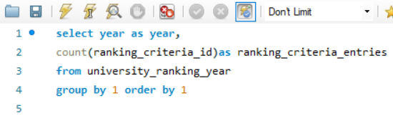
Q8. What is the distribution of total ranking criteria entries recorded for each year in the dataset
Query solved using SQL
Output of query
year | ranking_criteria_entries
2005 | 497
2006 | 497
2007 | 511

Slide 40
Q8. What is the distribution of total ranking criteria entries recorded for each year in the dataset
Graphic presentation

Slide 41
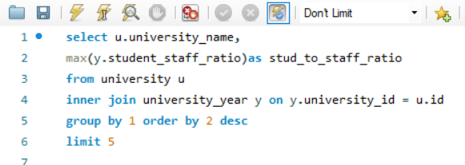
Q9. Is there a relationship between a university score and student_staff
Query solved using SQL
Output of query

Slide 42
Q9. Is there a relationship between a university score and student_staff
Graphic presentation

Slide 43
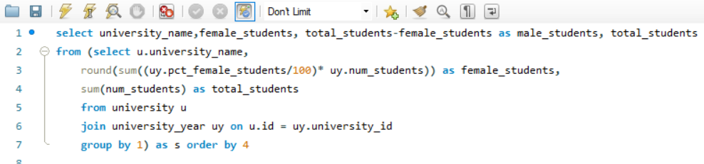
Q10.How does the number of female students differ among university
Query solved using SQL
Output of query

Slide 44
Q10.How does the number of female students differ among university
Graphic presentation

Slide 45
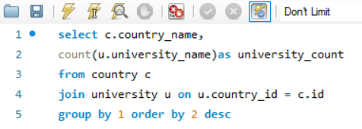
Q11. What is the distribution of universities across different countries?
Query solved using SQL
Output of query

Slide 46
Q11. What is the distribution of universities across different countries?
Graphic presentation

Slide 47
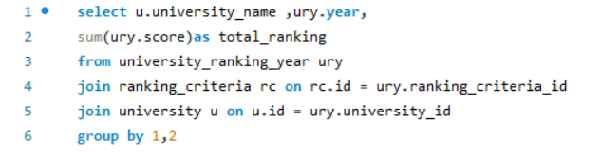
Q12. How has the ranking of universities changed over the years?
Query solved using SQL
Output of query
university_name | year | total_ranking
Harvard University | 2011 | 1171
California Institute of Technology | 2011 | 986
Massachusetts Institute of Technology | 2011 | 555

Slide 48
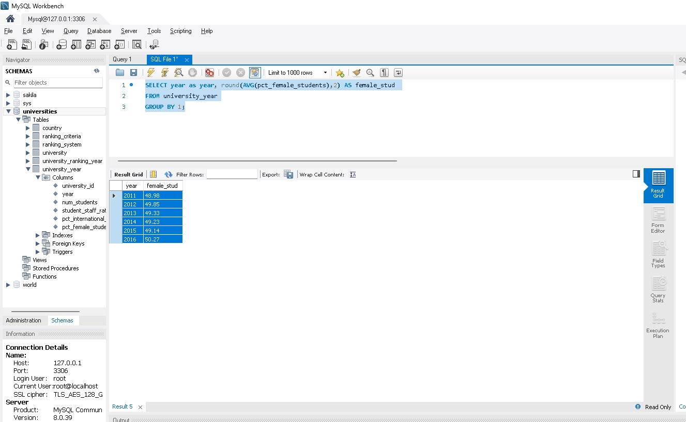
Q13. What is the percentage of international students, female students, and total students across different years?
Query solved using SQL
Output of query

Slide 49
Q13. What is the percentage of international students, female students, and total students across different years?
Graphic presentation

Slide 50
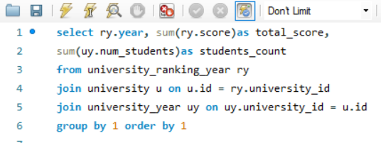
Q14. How has the ranking score of university evolved over the years
Query solved using SQL
Output of query

Slide 51
Q14. How has the ranking score of university evolved over the years
Graphic presentation

Slide 52
Q15. Is there a relationship between a university's ranking score and the number of students over time?
Query solved using SQL
Output of query

Slide 53
Q15. Is there a relationship between a university's ranking score and the number of students over time?
Graphic presentation

Slide 54
Thank You

